Slide 1


Principles of Programming Languages
(CS F301)
Jabez Christopher
Assistant Professor
Department of CSIS

Slide 2

Principles of Programming Languages
(CS F301)
Names, Bindings and Scope
Jabez Christopher
Assistant Professor
Department of CSIS

Slide 3
Names / Identifiers
A name is a string of characters used to identify some entity in a program.
Usually no length-limit.
A letter followed by a string consisting of letters, digits, and underscore characters
Camel notation Eg. printStackTrace.
PHP: Names must begin with a dollar sign
Ruby: @ or @@ indicate that the variable is an instance or a class Variable
C-based languages: case-sensitive

Slide 4
Special Words
used to make programs more readable
used to separate the syntactic parts of statements
reserved words cannot be redefined by programmers
Eg: Fortran
Integer Real // Real is to be of Integer type
Real Integer //Integer is Real type
Keyword special only in certain contexts.
Integer Apple //Declarative
Integer = 4 //Variable
COBOL has 300 reserved words

Slide 5
Variable
A variable can be characterized as a sextuple of attributes:
(name, address, value, type, lifetime, and scope)
It is an abstraction of a computer memory cell
Variable NAME
Variable names are the most common names;
Exception- Explicit heap-dynamic variables are nameless (abstract) memory cells that are allocated and deallocated by explicit run-time instructions
Variable ADDRESS
It is the machine memory address with which it is associated
Same variable can be associated with different addresses at different times in the program. Eg. Local variable in a subprogram called at different times
The process of associating variables with addresses is called Storage Binding

Slide 6
Variable
✗ hindrance to readability.
✗ complicates program verification
Variable ADDRESS (cont… )
Aliases - more than one variable name used to access the same memory location
Two pointer variables can be aliases. (reference variables)
Two variable names when they point to the same memory location.
a.k.a. l-value It is required when the name of a variable appears in the left side
of an assignment.
Variable TYPE
Type of a variable determines the range of values the variable can store.
Variable VALUE
It is the contents of the memory cell
a.k.a. r - value It is required when the name of the variable appears in the right side of an assignment statement. To access the r - value, the l-value must be determined first.

Slide 7
Binding
Association between an attribute and an entity
Can happen at:
Language design time – bind operator symbols to operations
Language implementation time – int is bound to its range
Compile time – bind a variable to a type in C or Java
Load time – Variable bound to a memory cell
Runtime – bind a nonstatic local variable to a memory cell or a call to library function.

Slide 8
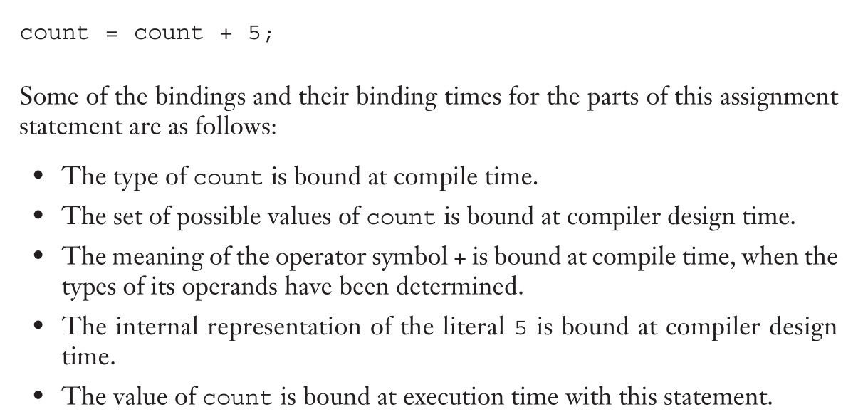
Binding – Example
Reference: Textbook, Section 5.4, Chap. 5

Slide 9
Binding – Attributes to Values
A binding is static if it first occurs before run time and remains unchanged throughout program execution.
A binding is dynamic if it first occurs during execution or can change during execution of the program.
Bindings by hardware
Due to paging/segmentation, the address space in which the cell resides may be moved in and out of memory many times during program execution

Slide 10
Binding – Variable to Data Type: STATIC BINDING
EXPLICIT DECLARATION: lists variable names and specifies that they are a particular type
IMPLICIT DECLARATION: associates variables with types through default conventions, rather than declaration.
Naming conventions: the compiler or interpreter binds a variable to a type based on the syntactic form of the variable’s name
Type inference: the context of the appearance of a name is the basis for determining its type.
Implicit and default declarations can be detrimental to reliability

Slide 11
Binding – Variable to Data Type: DYNAMIC BINDING
The variable is bound to a type when it is assigned a value in an assignment state-
ment.
May also bind the variable to an address and a memory cell, because different type values may require different amounts of storage.
Names can be bound to variables and variables can be bound to types.
Advantage: Programming flexibility
Disadvantages:
Speed penalty for type checking and interpretation
Type error detection by the compiler is more difficult hence causes programs are less reliable

Slide 12
Storage Bindings and Lifetime
Allocation: memory cell to which a variable is bound, is taken from a pool of available memory
Lifetime: time during which the variable is bound to a specific memory location
Taxonomy: based on lifetime
Static
Stack-dynamic
Explicit heap-dynamic
Implicit heap-dynamic

